Slide 1
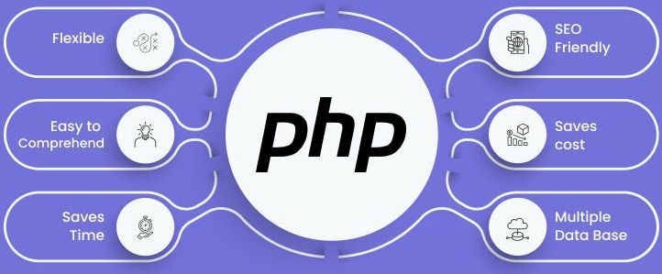

Slide 2
About today…
Object Oriented Programming
Encapsulation
Polymorphism

Slide 3
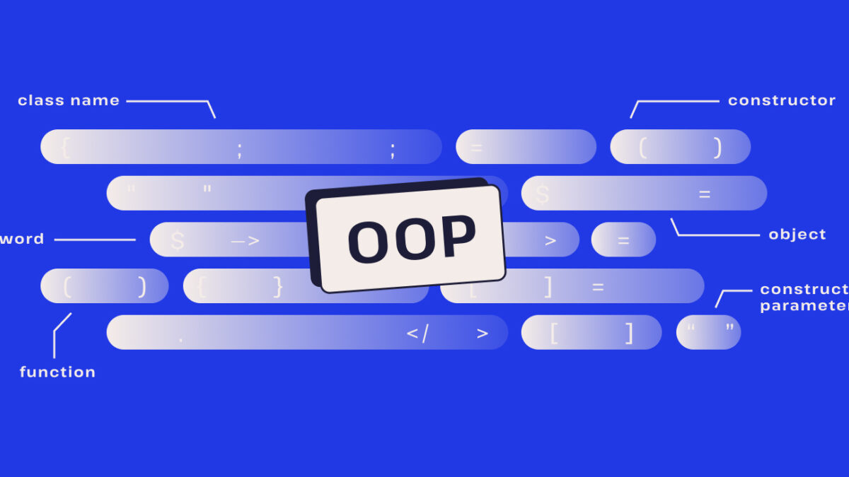

Slide 4
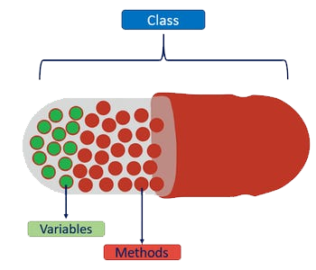
Encapsulation in PHP
Definition
Bundling of data and methods, that operate on the data within a single unit or class
Purpose
To restrict direct access to some of the object's
components and protect the object's integrity

Slide 5




private
Access modifier that restricts access to the class members
public
Access modifier that allows access to the class members
Use of getters and setters to access private properties

Slide 6

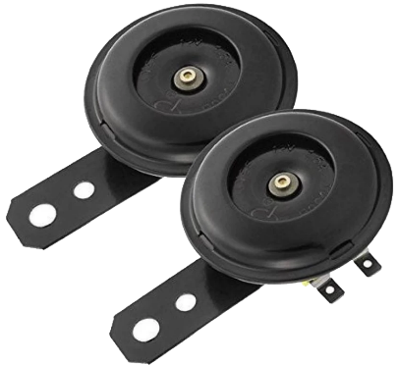

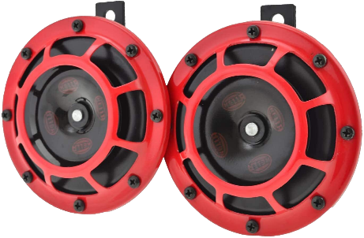
Polymorphism in PHP
Definition
Polymorphism allows methods to do different things based on the object it is
acting upon
Purpose
Enables a single interface to represent different underlying forms (data types)

Slide 7


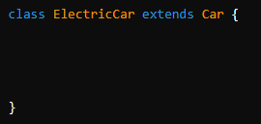



Method overriding demonstrates polymorphism

Slide 8


Slide 9

What is encapsulation in PHP?
Which keyword is used to implement encapsulation in PHP?
What is polymorphism in PHP?
Which principle does polymorphism relate to in object-oriented programming?

Slide 10

Task 1
Create a PHP class called Student with private properties like name and age. Add public methods to set and get these properties. Instantiate the class and demonstrate how encapsulation ensures data privacy by accessing the properties through the public methods only
Task 2
Create a PHP interface called Shape with a method calculateArea(). Implement this interface in two classes: Rectangle and Circle. Each class should have its own implementation of calculateArea(). Instantiate both classes, call their calculateArea() methods, and observe how polymorphism allows the same method to behave differently based on the object type

